Slide 1

Department of Computer Science & Engineering Project Phase-2 Presentation
Internet of Things in Agriculture:
A Support System for Agriculture
Project Team
Manoj Kumar I (1DB19CS084)
Monish P (1DB19CS086)
Chaitra MP (1DB19CS087)
Nisarga K (1DB19CS097)
Guide
Dr Manjunathswamy BE
Associate Professor
Dept of CSE

Slide 2
CONTENTS
Introduction
Abstract
Objectives
Problem statement
Literature survey
Existing System
Proposed System
Implementation
References

Slide 3
INTRODUCTION
Agriculture is the main source of income for most people in India and contributes significantly to the Indian economy.
Smart agriculture, also known as precision agriculture, is an advanced farming method that utilizes cutting-edge technologies to increase crop yield, optimize resource utilization, and reduce environmental impact.
By integrating various technologies such as sensors, drones, artificial intelligence, and data analytics, smart agriculture enables farmers to make data-driven decisions, monitor crop health and growth, and automate various farming processes.
Food prices are constant, because the quality of the plants has dropped. There are a number of factors that cause this may be due to water litter, low soil fertility, fertilizer misuse, climate change or diseases etc.
It is very important to do it successfully agricultural interventions and the solution is IoT to integrate with the wireless sensor network. Internet of Things (IoT).

Slide 4
ABSTRACT
Agriculture is a critical sector for global food production and plays a vital role in the world's economy. However, farmers face numerous challenges in managing their crops, including unpredictable weather patterns, pest infestations, and animal damage. These challenges can significantly impact crop growth and yield, leading to economic losses for farmers. In addition, traditional methods of monitoring environmental conditions in fields, such as manual measurements, are time-consuming and labor-intensive.
The Agriculture Field Monitoring System using IoT Sensors project aims to address this need by developing an IOT-based system that provides farmers with real-time data on the environmental conditions in their fields, enabling them to make informed decisions about crop management and reduce crop losses.

Slide 5
OBJECTIVE
To develop an IoT-based system that can measure and monitor the environmental conditions in agriculture fields in real-time.
To provide farmers with real-time data on the amount of rainfall, soil moisture content, temperature, and the presence of animals in the field, enabling them to make informed decisions.
To reduce crop losses caused by animal damage or extreme weather conditions by providing farmers with timely information on the environmental conditions in their fields.
To develop a cost-effective and easy-to-use solution that is accessible to small-scale farmers.
To integrate the system with the Telegram application to provide farmers with remote access to the environmental condition data of their fields.
To customize the system to suit specific crop types and environmental conditions, providing greater flexibility and accuracy in monitoring the environmental conditions of the fields

Slide 6
PROBLEM STATEMENT
The “Internet of Things in Agriculture: A Decision Support System for Precision Farming” is to help the farmers to better understand the important factors to make easier such as water ,soil types. The proposed method uses different sensors like moisture, humidity, rain sensor in order to detect heavy rainfall.
If heavy rainfall detected, panels are automatically closed. All the operations can be implemented in both automatic and manual mode.
We have used various sensors such as humidity sensor, rain sensor, temperature sensor, moisture sensor light sensor, motion detection sensor which will be initially set to default values suitable for the cultivation.

Slide 7
LITERATURE SURVEY
SL NO. | TITLE | AUTHOR | PUBLISHED | DESCRIPTION
1 | “A Smart Farming and Crop Monitoring Technology in Agriculture Using IOT” | Raj Aryan, Ankur Mishra, Sachin Kumar, Ms. Sonia Kumar | 2022 | Monitoring the environmental factor is not the complete solution to increase the yield of crops. There are no of factors that decrease the productivity to a great extent. Hence Automation must be implemented in agriculture to overcome these problems. An automatic irrigation system thereby saving time, money and power of farmer. The Traditional Farm techniques require manual intervention. With the automated technology of irrigation the human intervention can be minimized.
2 | “IOT based smart agriculture” | Dr.N.Suma, Sandra Rhea Samson , S. Saranya, G. Shanmugapriya , R. Subhashri | 2016 | The newer scenario of decreasing water tables, drying up of rivers and tanks, unpredictable environment present an urgent need of proper utilization of water. To cope up with this use of temperature and moisture sensor at suitable locations for monitoring of crops is implemented. An algorithm developed with threshold values of temperature and soil moisture can be programmed into a microcontroller-based gateway to control water quantity.

Slide 8
SL NO | TITLE | AUTHOR | PUBLISHED | DESCRIPTION
3 | “Iot based smart greenhouse” | Ravi Kishore Kodali, Vishal Jain and Sumit Karagwal | 2018 | India receives ample amount of precipitation and have many large river systems but still only one third of the total agricultural land is connected via canal irrigation system. Remaining majority of the portion is dependent on monsoon or tube wells. Places with excess water faces problem of land sanity due to over irrigation and water logging. Water collected on the surface also blocks pores in the soil and kills beneficial microorganisms. So a Iot Based solution provided
4 | ‘‘Indoor air quality monitoring using wireless sensor network,’ | S. Bhattacharya, S. Sridevi, and R. Pitchiah, | 2019 | A remote sensing and control irrigation system using distributed wireless sensor network aiming for variable rate irrigation, real time in field sensing, controlling of a site specific precision linear move irrigation system to maximize the productivity with minimal use of water was developed in security framework in RFID multi-domain system. The system described details about the design and instrumentation of variable rate irrigation, wireless sensor network and real time in field sensing and control by using appropriate software. The whole system was developed using five in field sensor stations which collects the data and send it to the base station using global positioning system (GPS) where necessary action was taken for controlling irrigation according to the database available with the system.

Slide 9
EXISTING SYSTEM
Agricultural activities continue to be one of outstanding livelihood strategies. Food production plants do not depend on any officially acquired plants agricultural knowledge.
Especially in rural areas, farmers follow traditional production methods their food crops with the help of the environment.
Using common agricultural techniques, the labor required of a farm is more than a building good harvest. To get the best yield, we need you to protect the crop from pests.
This pest control is made in traditional ways that farmers use spraying pesticides to kill problems from the field using sprays.
There is a loss in the harvest. As we do not know about daily weather reports, either the need depends on rainfall and the flow of river water to irrigation system and river.
Proposed A new agricultural system is being developed for transformation which makes traditional farming a high yield production and for-profit

Slide 10
PROPOSED SYSTEM
The proposed Agriculture Field Monitoring System using IoT Sensors project is designed to measure and monitor the environmental conditions in agriculture fields in real-time.
The system is comprised of several sensors, including rain sensors, moisture sensors, temperature sensors, and an IR sensor for animal detection.
These sensors are connected to a microcontroller that processes the data and sends it to an LCD display for real-time monitoring by farmers.
Additionally, the data is sent to the Telegram application for remote access by farmers. The system is designed to be customizable to suit specific crop types and environmental conditions, providing farmers with accurate and relevant data to support their crop management decisions.
The IR sensor is designed to detect the presence of animals in the field and trigger an alarm to alert farmers of the potential damage to their crops.
The LCD display provides a clear and concise display of the environmental conditions data, making it easy for farmers to monitor and respond to changes in the field.

Slide 11
IMPLEMENTATION
HARDWARE USED
HUMIDITY SENSOR :
Humidity monitoring is essential for crops to estimate water losses due to
evaporation which is vital for the process of photosynthesis.
DHT11 Humidity sensor incorporates a damp sensor
complex with a standard digital signal output.
Its small size, low power transmission up to 20 meters signal.

Slide 12
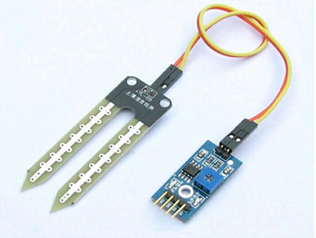
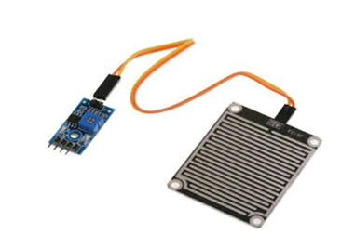
SOIL MOISTURE SENSOR :
Soil sensor is a sensor that feels the moisture of the earth with monitoring parameters like pH and soil conductivity
The sensor has both analogs as well digital output. Digital output is
fixed and analog output limits may vary. The soil moisture sensor consists of two probes that measure the volume of water in the soil. The two probes allow the electric current to pass through the soil and, according to its resistance, measures the moisture level of the soil.
RAIN SENSOR :
Rain sensor module is a simple rain detection tool. Rain sensors are a type of rain shutoff device designed to pause irrigation when there is a significant amount of rainfall.

Slide 13
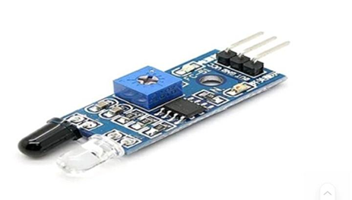
INFRARED SENSORS :
sensors are able to detect live objects that move, especially large ones. An infrared sensor is used to emit light to hear something in the surrounding area. Can measure the temperature of the object and then detects the movement of things. Generally, in the infrared spectrum, everything objects emit a certain type of radiation. These types of radiation are invisible to our eyes; however the infrared sensor can detect these rays.
WI-FI MODULES :
The ESP8266 Wi-Fi Module is a standalone system chip with built-in TCP / IP protocol stack enabled microcontroller to access Wi-Fi network. power consumption is not an issue , The transmission distance are lower in range of 100ft only.

Slide 14
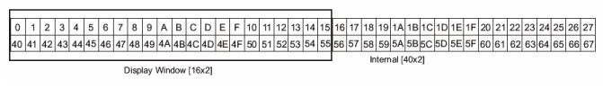
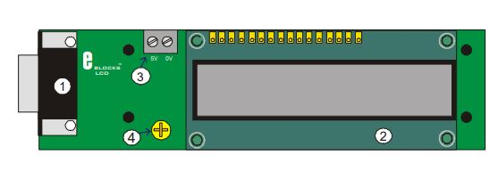
LCD: Liquid Crystal Display
This is an LCD Display designed for E-blocks. It is a 16 character, 2-line alphanumeric LCD display connected to a single 9-way D-type connector. This allows the device to be connected to most E-Block I/O ports. The LCD display requires data in a serial format, which is detailed in the user guide below. The display also requires a 5V power supply. Please take care not to exceed 5V, as this will cause damage to the device

Slide 15
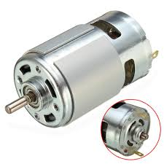
DC MOTOR
Here the DC motor is used to make the roof automatic in opening and closing whenever it rains and when the rain stops respectively. A D.C. motor is a machine that converts D.C. electrical energy into mechanical energy D.C. motor works on the principle that, when a current carrying conductor is placed in a magnetic field, a mechanical force is experienced on the conductor in a magnetic field

Slide 16
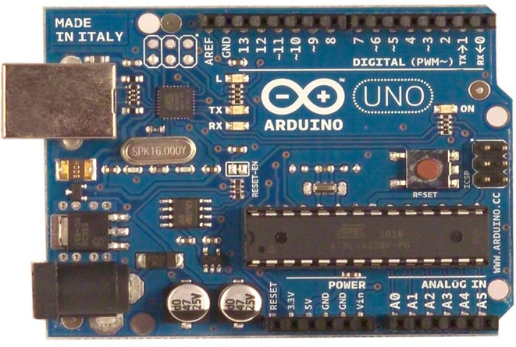
ARDUINO UNO:
Arduino Uno is a small controller with open-source board based on Microchip ATmega328P microcontroller and developed by
Arduino. Cc its easy-to-use hardware and software.
It is an open source computing platform that is used for
constructing and programming electronic devices. It is
also capable of acting as a mini computer just like other
microcontrollers by taking inputs and controlling the
outputs for a variety of electronics devices.

Slide 17
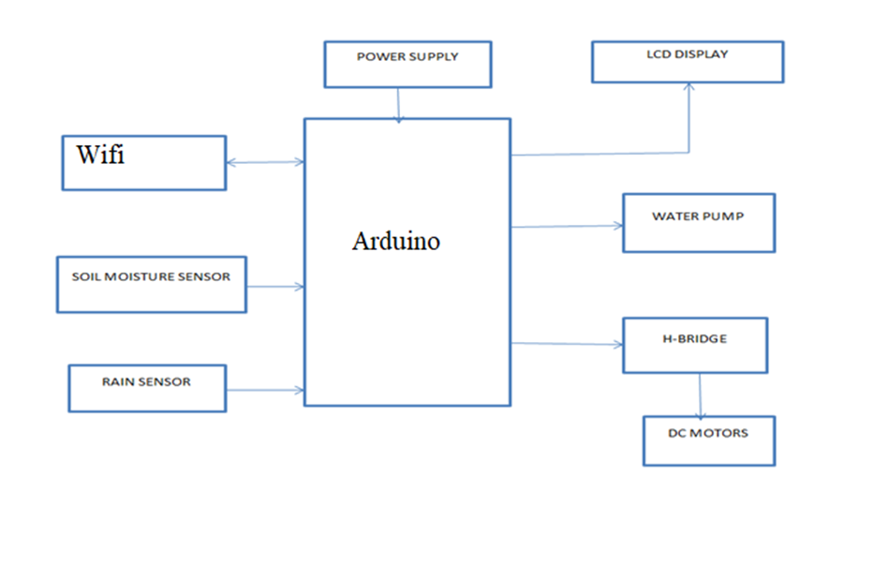
ARCHITECTURE

Slide 18
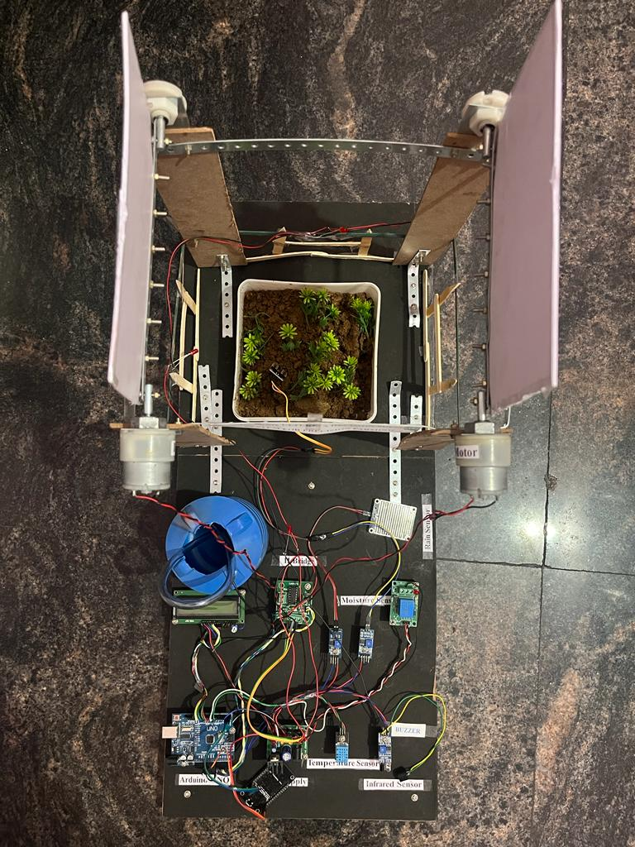
Results and outcomes
Enhanced Monitoring and Data Collection
Precision Farming
Automated Systems and Remote Control
Early Detection of Crop Diseases and Pests
Decision Support Systems
Resource Optimization

Slide 19
REFERENCES
[1] Raj Aryan, Ankur Mishra, Sachin Kumar, Ms. Sonia Kumar, “A Smart Farming and “Crop Monitoring Technology” in Agriculture Using IOT” 2022
[2] Dr.N.Suma,Sandra Rhea Samson , S. Saranya, G. Shanmugapriya , R. Subhashri Associate Professor, Department of ECEJournal of Advanced Research in Computer and Communication Engineering 2016 papers about IOT based smart agriculture.
[3] Ravi Kishore Kodali, Vishal Jain and SumitKaragwal Department of Electronics and Communication Engineering Kodali2016 papers gives information about Iot based smart greenhouse.
[4]S. Bhattacharya, S. Sridevi, and R. Pitchiah, ‘‘Indoor air quality monitoring using wireless sensor network,’’ in Proc. 6th Int. Conf. Sens. Technol. (ICST), Dec. 2012, pp. 422–427.
[5] Yu liu, KahinAkram hassan1, Magnus Karlsson1, Ola Weister, and Shaofang gong Department of Science and Technology established Active Plant Wall for Green Indoor Climate Based on Cloud and Internet of Things.
[6 ] D. Y. Kim, T. H. Shin, and J. S. Park, “A security framework in Rfid multi-domain system,” in Availability, Reliability and Security, 2007.ARES 2007.

Slide 20
THANK YOU

